Slide 1

The Team:
Producer:
Juli Gregg
Game Designer:
Luke Conlon
Tech Director:
Dan Muller
Project Manager:
Kaden Nugent

Slide 2
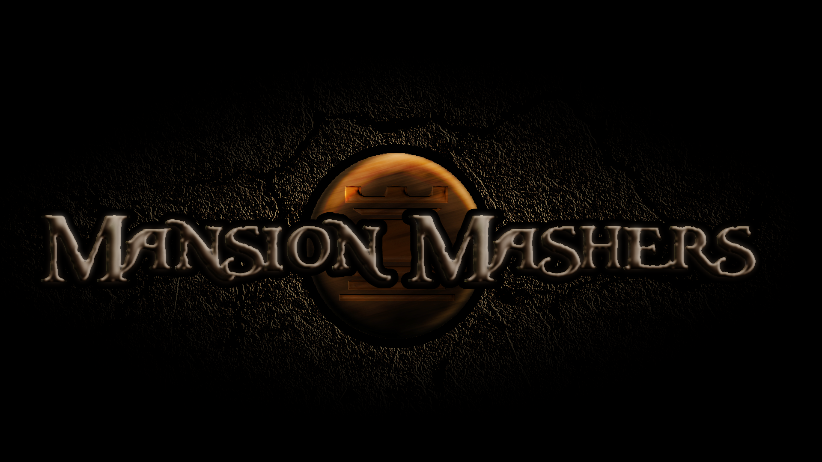

Slide 3

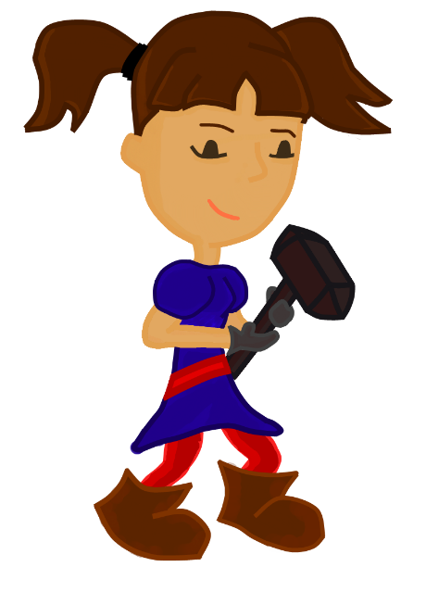

High Concept:
A 2-D cartoon fantasy dungeon crawler side-scrolling hack and slash game

Slide 4

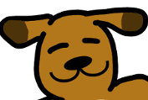
Summary:
Two rival clans:
VS
Play as a mighty princess in
a mission to rescue a captured prince
Save the prince save your clan!

Slide 5

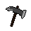
Mechanics:
Translation based movement
Minor platforming
Melee combat
Scripted Boss fights

Slide 6
Demo

Slide 7
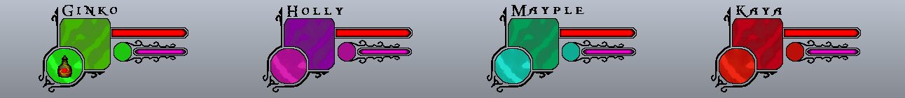
Stretch Goals:
Multiplayer
Cooperative AI Pets
Special Items

